Slide 1
SUSANNAH SULSAR,
director customer experience marketing
Barkley
THE HUMAN EXPERIENCE
Bridging the Gap between
Customer Experience and
User Experience
SXSW 2016
#HumanX
Leah buley,
principal analyst Customer experience
forrester

Slide 2

premise
The Domain of traditional Customer Experience
The Domain of traditional User Experience
The most innovative companies are infusing modern experience design processes within the strategy and customer understanding phases of the traditional Customer Experience practice, and infusing data and measurement into the design phase of the traditional User Experiences practice.

Slide 3
Workshop
This workshop will allow participants a hands-on opportunity to use Design Thinking, along with their common experience in registering for and attending SXSW Interactive conference, to marry CX and UX to create a Transformative Human SXSW Experience.

Slide 4




the evolution of user experience
The User Experience practice is evolving
Past the point where experiences need to work across channel and be personalized and contextualized
To the point where the experience must generate VALUE for the customer.
Usable
Ubiquitous
Transactional
Transformative
Focus: Reduce Errors
Increase Efficiency
Expert Users
Focus: Conversion
Task Oriented
Personas & Paths
Focus: Cross Channel
Personalized & Contextualized
Focus: Value & Engagement
Emotion
Process shift to non-digital

Slide 5


The evolution of customer experience
Likewise the Customer Experience practice is evolving
Past the point where experiences need to work across channel and be personalized and contextualized
To the point where the experience must generate VALUE for the customer.
Service
Interactions
Satisfaction
Human
Focus: Resolving Issues
UX Internal Systems
CSat related to service
Focus: Measurement
UX Digital
CSat + Brand Perception
Focus: Consistency
Personalized & Contextualized
Focus: Value & Engagement
Emotion
Lead with XD
Sound familiar?

Slide 6
HUMAN Experience Design
The conversion of CX and UX
As the two practices start converging with the same goals, there are a few stand out truths:
Data alone cannot define the experience. The Human/emotional aspects of a customer’s experience have the biggest influence on loyalty. Understanding and playing to consumer emotion in your experience planning will positively affect your bottom line.
Businesses must strike a balance between finding and fixing existing experiences with bolder innovation-based efforts that reinvent experiences and deliver new value to customers.
Traditional Customer Experience and User Experience practices can no longer behave like silos.

Slide 7

TOPIC 1: the real voice of customer
Customer Understanding is not the domain of either Customer Experience OR User Experience.
To learn: Sources of insights from both practices and where/how to get them with limited teams/resources.
To do: Document the customer needs — beyond SXSW specific Interactions.

Slide 8


Topic 2: Journey Mapping for humans
Customer needs begin long before they begin engaging with a brand. What can be gained by creating a journey map that extends beyond brand engagement?
To learn: The role of a journey map and what it is/isn’t.
To do: Create an aspirational Journey Map for SXSW Interactive.

Slide 9

Topic 3: recognizing opportunities
Not every idea is an opportunity. Creating a brief for experience design teams means prioritizing efforts. Once you stop any bleeding, then what?
To learn: How to identify and prioritize the experiences that matter.
To do: Identify the top 3-5 opportunities for SXSW.

Slide 10

Topic 4: the soft stuff: culture
Even if your team can figure out how to marry these concepts, if the Culture of Experience doesn’t exist in your organization, you’ll struggle to keep up any momentum.
To learn: Defining governance and culture, and what is involved.
To do: Conduct your own organizational Experience assessment.

Slide 11
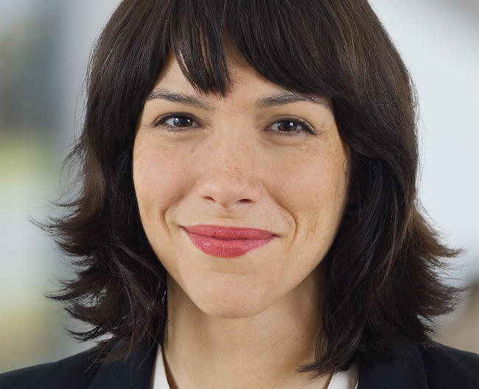
Leah buley,
principal analyst Customer experience - forrester
Leah is an analyst at Forrester Research, researching and writing about the user experience field after 15 years living in it. Prior to Forrester she worked as a design strategist at Intuit, where she worked on the future of business and personal finance, and as an experience design lead at Adaptive Path, a pioneering user experience design consultancy. She started her career in the late 1990s as an opinionated Web developer. Through self-taught tinkering she gradually made the transition to user interface design. She spent the early 2000s as a UX team of one in a range of financial and information service companies. That experience led her to write The User Experience Team of One, a book she wished she’d had in the early days of her career.

Slide 12
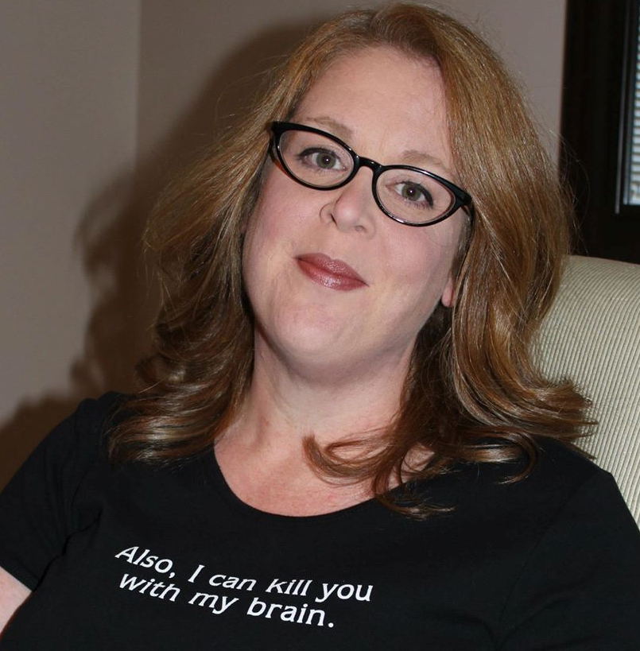
SUSANNAH SULSAR,
director customer experience marketing - Barkley
Every marketing team needs a data strategist who is also the champion of the customer: Someone who knows their customer and program data inside and out. Susannah has 20 years experience using customer relationship marketing data to help Fortune 500 companies build customer insight on preferences and attitudes, optimize 1:1 communications to better engage customers, and build multi-channel customer experience strategies. As the (Fiercely Independent) Director of Customer Experience Marketing at Barkley (A Fiercely Independent Advertising Agency), Susannah's passion for data strategy and customer experience marketing means she occasionally geeks on topics like email, database marketing, and journey mapping.

